Slide 1
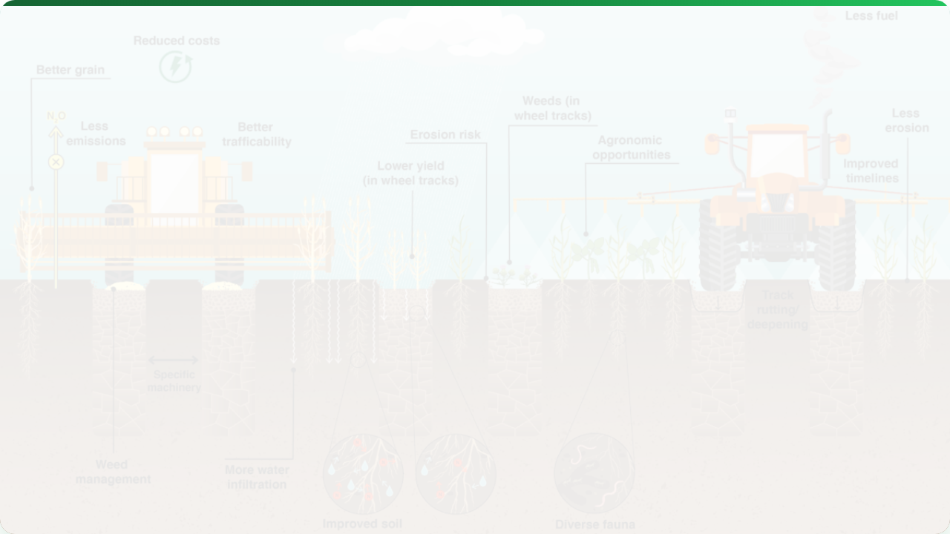



ECONOMIC & ENVIRONMENTAL IMPACTS
Lecture 14: The Triple Bottom Line
AGE 418
Dr. Kadeghe Fue

Slide 2




Lecture Roadmap
Economics
Sustainability
Cost-Benefit Analysis
The Triple Bottom Line
ROI of Precision Tech
Soil & Water Conservation
Adoption Barriers
Social Impacts

Slide 3

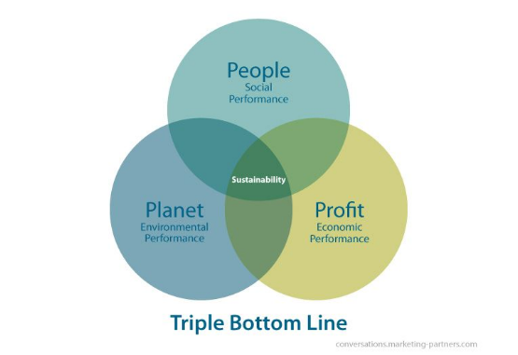
The Triple Bottom Line
True sustainability sits at the intersection of:
Profit (Economic): Must be viable.
Planet (Environmental): Must be regenerative.
People (Social): Must be equitable.

Slide 4


Economic Driver: Profitability
Precision Agriculture increases profit by:
Reducing Inputs
Increasing Yield
Less fertilizer, chemical, and fuel wasted in non-productive zones.
Optimizing population and nutrients in high-potential zones.

Slide 5
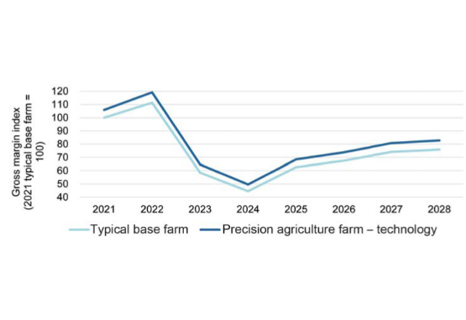
Return on Investment (ROI)
Does it pay off?
Guidance: Quickest payback (1-2 years) due to fuel/time savings.
VRT: Slower payback (3-5 years) but higher long-term efficiency.

Slide 6
Barriers to Adoption
Barrier | Description
Capital Cost | High upfront price for sensors, screens, and hydraulics.
Complexity | Steep learning curve for software and data management.
Compatibility | "Does my Blue tractor talk to my Red planter?" (Interoperability).

Slide 7
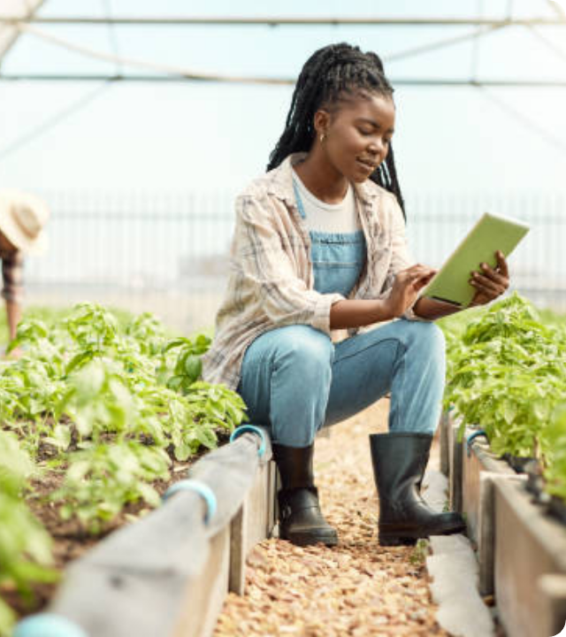

Environmental Stewardship
"Doing More With Less"
PA allows farmers to maintain high yields while reducing their ecological footprint.
Goal: Sustainable Intensification.

Slide 8
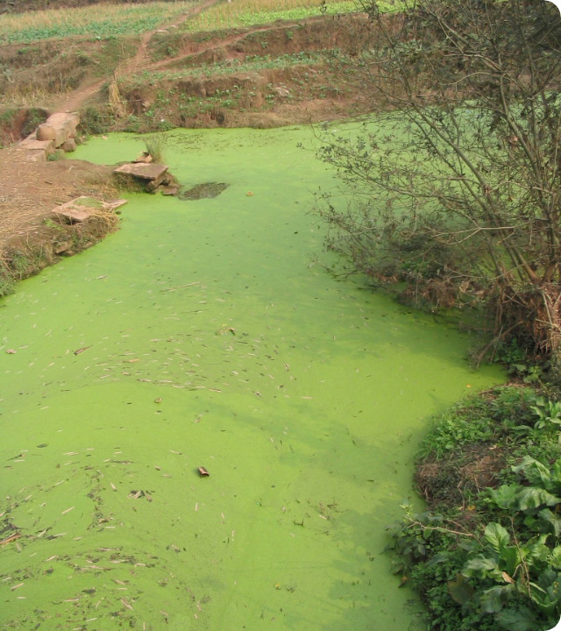
Nutrient Pollution
The Problem: Excess Nitrogen runs off into waterways, causing Eutrophication (Algal Blooms).
The PA Solution: Variable Rate Application (VRA) places fertilizer only where the crop can use it, reducing runoff potential.

Slide 9
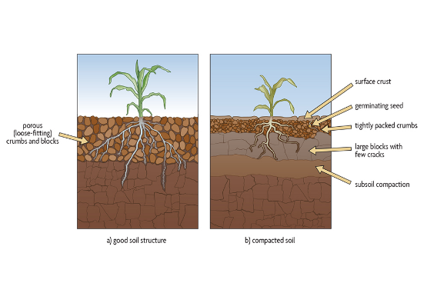
Soil Health & Compaction
Heavy machinery crushes soil pores, killing biology and reducing water infiltration.
Solution: Controlled Traffic Farming (CTF).
Concept: Driving on permanent tramlines year after year.
Result: 80% of the field is never driven on.

Slide 10




Reducing Chemical Load
Spot Spraying
Drift Control
"See & Spray" robots target weeds only.
Pulse Width Modulation (PWM) maintains droplet size to prevent drift.
-90% Herbicide Use

Slide 11


Water Conservation
Every Drop Counts.
Smart Drip
Flood Irrigation
95% Efficient
50% Efficient
Water applied directly to roots based on sensor demand.
High evaporation & runoff.

Slide 12


Social Impacts (People)
Labor Safety
Skills Gap
Robots handle dangerous tasks (spraying), reducing human exposure to toxic chemicals.
Shift from physical labor to "Knowledge Workers". Demand for data analysts and drone pilots in rural areas.

Slide 13
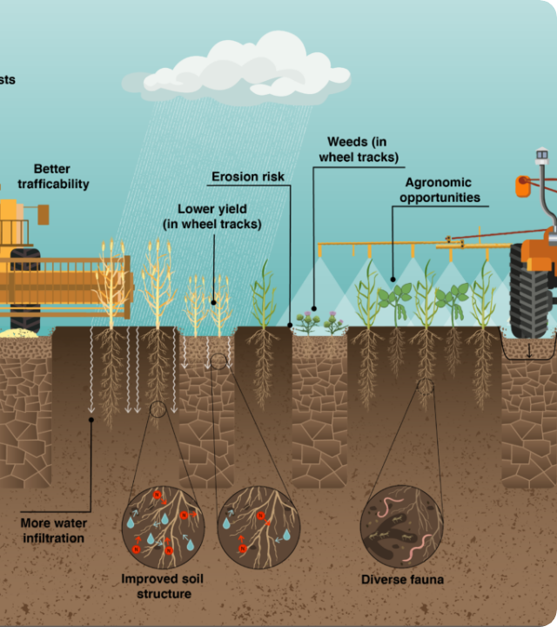
Case Study: CTF
Controlled Traffic Farming.
Method: All machinery shares the same wheel gauge and GPS lines.
Impact: Soil porosity increases, roots go deeper.
Result: 15-20% Yield increase and 50% less fuel used (driving on hard tracks).

Slide 14

Local Context: Tanzania
Can smallholders afford this?
Service Economy Model:
Farmers don't buy the drone; they hire a "Spray Service Provider" (SSP) who uses a drone.
This democratizes access to high-tech sustainability tools.

Slide 15

Lecture Summary
Economic
Environmental
Social
PA improves profitability through efficiency (Lower inputs, Higher outputs).
Reduces runoff, compaction, and chemical load. Protects soil and water.
Improves safety but requires new technical skills.
Next Class: Lecture 15 - Future Trends & Course Wrap-up

Slide 16

Questions?
Dr. Kadeghe Fue | AGE 418
Sokoine University of Agriculture

